Slide 1
From Pinot Pitfalls to ClickHouse Triumph
A 3 month migration
Abhijeet Kushe
Software Engineer Data platform Engineering @ Constant Contact

Slide 2
Background
In Fall 2021 Constant Contact launched Automated Path Builder (APB)
Allowed customers to engage with their contacts in realtime
Send reminders, welcome letters from user actions eg clicks, opens, order checkouts
In Summer 2022 we launched SMS
Integrated with APB and Bulk campaigns features
Reporting requirements
Real-time OLAP style queries across different dimensions eg workflow type, status
Reports latest state of the workflow

Slide 3
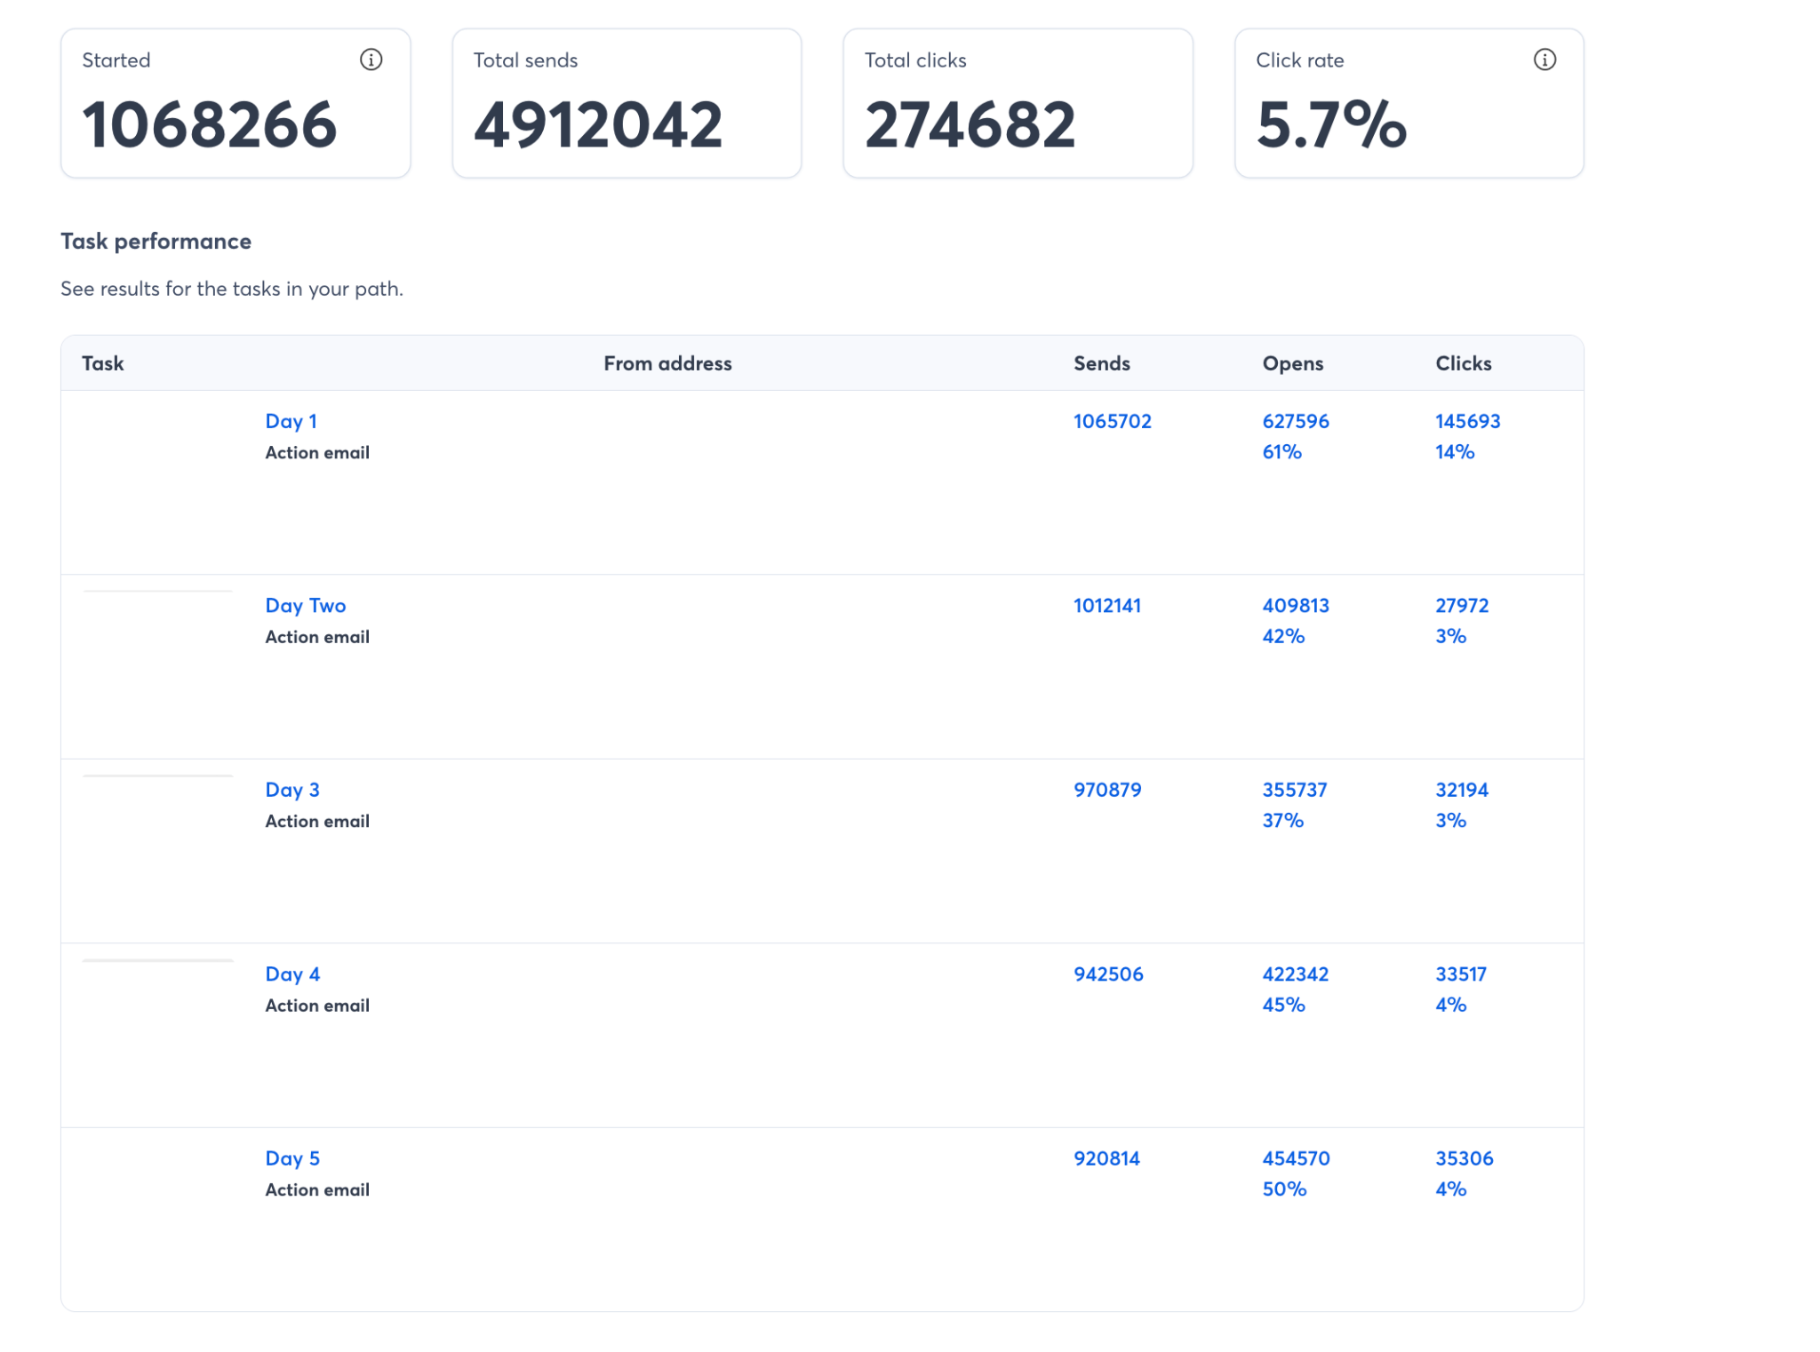
Example #1 APB Reporting Page

Slide 4
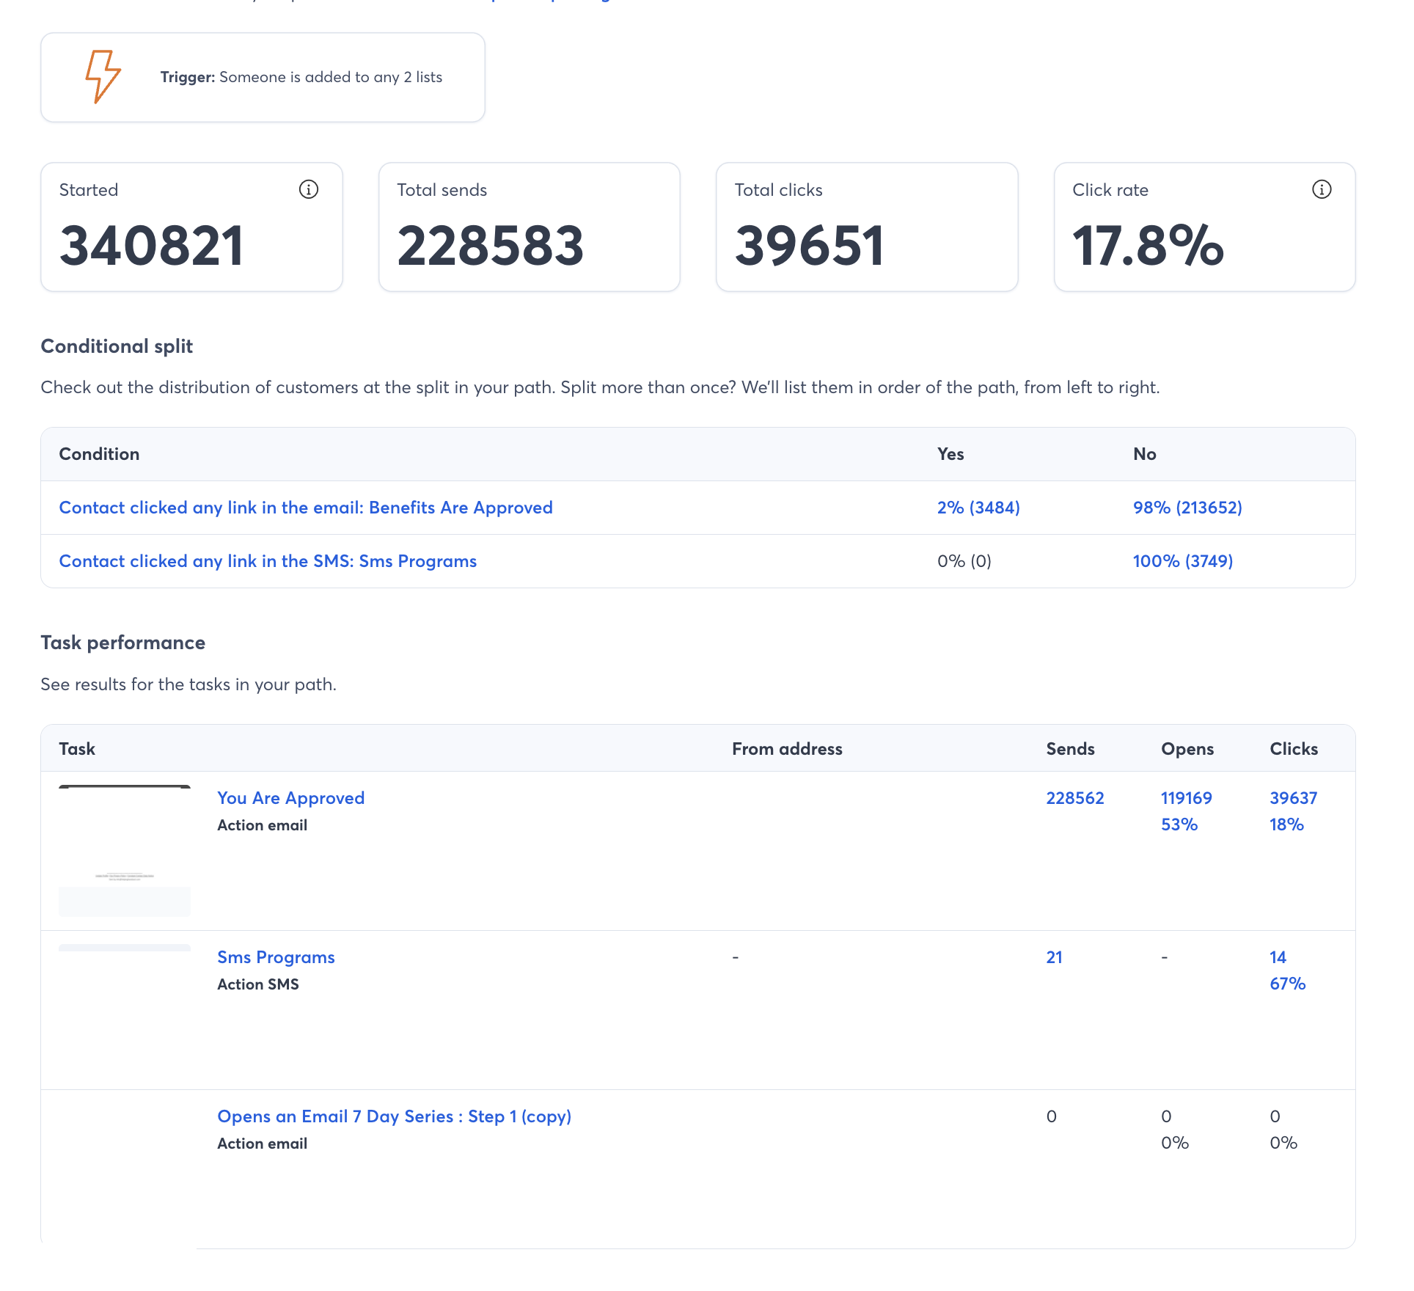
Example #2 APB Reporting Page

Slide 5
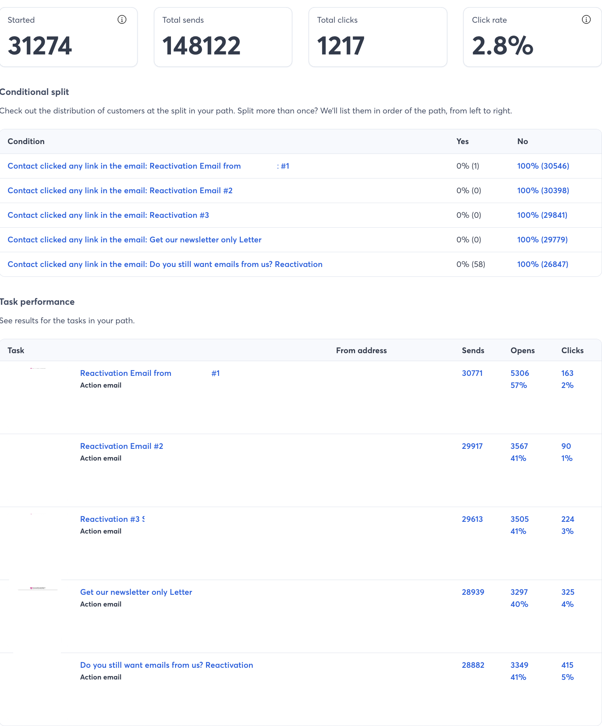
Example #3 APB Reporting Page

Slide 6
Need for a new Reporting software
Existing reporting softwares built on Cassandra and Mysql
100 node Cassandra Cluster good for fast point lookups
MySQL requires on pre aggregation and recalculation
Will not satisfy real-time OLAP queries
Apache Pinot Realtime Upsert fit the requirement
Integrates easily with Amazon Kinesis
Handles upserts at Query time
Good for data fixes and state management
Things were zooming for the first 6 months

Slide 7
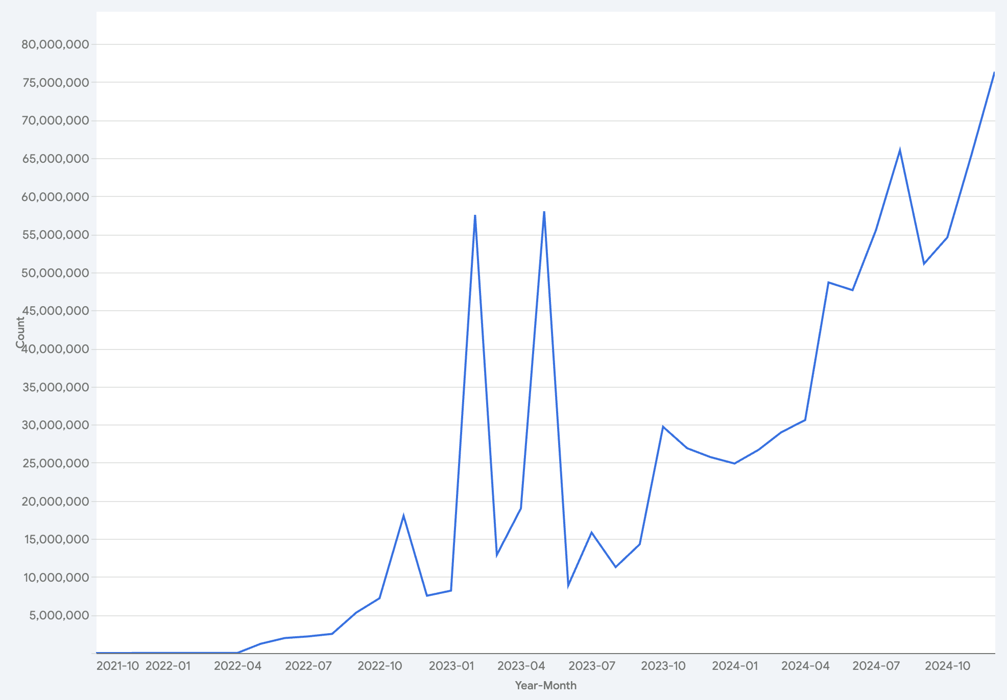
Events /Time
Maintenance Rolling restarts Instance Type change
Clickhouse Development
Maintenance memory, config changes Backfill + Restore
Good performance

Slide 8
Pinot Technical Limitations
Pinot upsert didn’t support compaction and multi-key ordering
Total 1000 segments/partition 180GB (Created 1 segment per day)
Forced us to add memory regularly
Cannot be repartitioned (Kinesis shards hardwired to partitions)
Apache Pinot Upsert recommends us to have 3 times the number of kinesis shards then volume
Migration to a new table was time consuming
No tool support for bulk import
Would have taken multiple weeks to stream into a new kinesis stream
Time was running out !

Slide 9
ClickHouse to the Rescue
Clickhouse Setup
Altinity Clickhouse Operator allowed a rapid clickhouse setup with few lines of code
Clickhouse bulk insert from S3 files
AWS Athena CTAS Queries helped generate compressed S3 json files
Entire table loaded within 3 hours via Insert from S3 statements
Clickhouse ReplacingMergeTree compatible with Pinot Upsert
Clickhouse Data types highly compatible with Pinot Data types
Additionally clickhouse has advanced data-types of ints, UUID, LowCardinality Strings
Clickhouse-benchmark is a easy-to-use tool for measuring performance
Helped in determining Instance Capacity Sizing and design decisions
Clickhouse Java api can be mapped with Pinot Java Client
Special Thanks to the awesome Clickhouse Support Team !

Slide 10
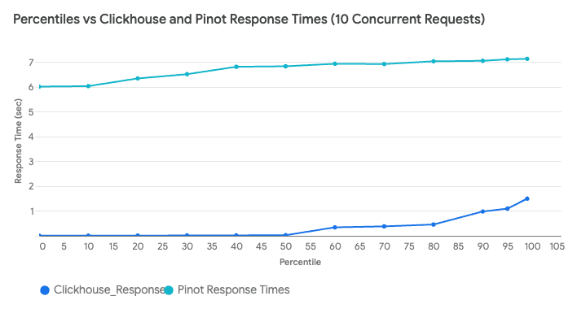
A Huge improvement in Performance!!
Pinot 4 servers, 3 brokers
Clickhouse 1 node , 1 thread

Slide 11
Pinot
Clickhouse
VS
MMAP (Memory mapped files) - More RAM than Segments - TLB Shootdowns Are you sure you want to use MMAP ?
Pread (Position reads) - Out performs MMAP in all cases (random, sequential reads) - Uses cpu prefetches and caches Thesis - Linux Memory Mapped System Call Performance
Columnar Storage - Uses custom columnar segment storage format - Compaction for upsert would need sophisticated algorithm
LSM Log Structured Merge Tree - Directly performs Merges of SSTables
Uses Java - Process needs 16GB heap memory
Uses C++ - Process needs 2GB
Component Heavy - Broker, Server, Controller, Zookeeper - $12.7/month
Component Light - Server, Clickhouse Keeper
- $ < 1.4K/month at 10x the speed

Slide 12
Lessons Learned
Know thy data!
Early detailed design decisions like int types, Enums vs Strings vs boolean, cardinality is worth the effort
25% compression is due to a strong schema design
Both order by and primary key are useful
Automate Backups and test restores
An hourly backup of Zookeeper helped in quick restore Pinot
For clickhouse we have daily backups
Mistakes will happen
Schema changes, incorrect order by, wrong field types
Important to select mature databases which support fast backfill

Slide 13
Demo

